Slide 1
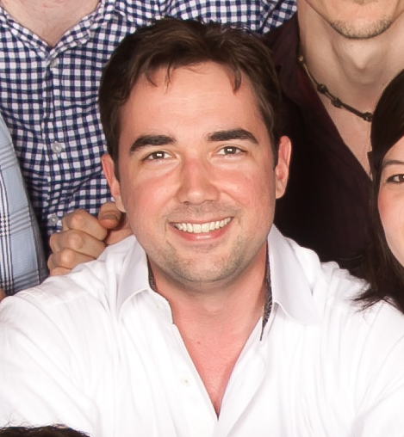
SOCIAL MEDIA
WITH KYLE WAHLQUIST
CHAIRMAN – GRAND LODGE INTERNET COMMITTEE
PAST MASTER – HILLCREST LODGE #1318
SENIOR DIGITAL STRATEGY CONULTANT - @CREDERA

Slide 2
WHY ARE WE TALKING ABOUT SOCIAL MEDIA?

Slide 3
WE KEEP HEARING THE MESSAGE “MASONRY HAS TO GET BACK OUT IN THE COMMUNITY” …

Slide 4
89% OF PEOPLE USE SEARCH ENGINES TO FIND OUT MORE ABOUT A TOPIC BEFORE MAKING A DECISION

Slide 5
90 PEOPLE SEARCH “HOW TO BECOME A FREEMASON”…

Slide 6
90 PEOPLE SEARCH “HOW TO BECOME A FREEMASON” IN
DALLAS COUNTY…

Slide 7
90 PEOPLE SEARCH “HOW TO BECOME A FREEMASON” IN
DALLAS COUNTY, PER MONTH

Slide 8
WE LIVE IN A DIGITAL AGE, AND THE COMMUNITIES ARE NOW ONLINE

Slide 9
FACEBOOK ALONE HAS 1.5 BILLION MEMBERS

Slide 10
IF YOUR LODGE IS NOT REPRESENTED ONLINE YOUR LODGE IS NOT “OUT IN THE COMMUNITY”

Slide 11
YOU CAN USE SOCIAL MEDIA AND YOUR BLOG TO STRATEGICALLY PROMOTE YOUR LODGE ONLINE.

Slide 12
WHAT IS SEARCH
ENGINE OPTIMIZATION?
1

Slide 13
WHAT IS SEARCH ENGINE OPTIMIZATION (SEO)?
SEO is the process of improving your website so that it attracts more visitors from search engines.

Slide 14
Digital Methodology
ATT RACT
CONVER T
CLOSE
EVANGELIZE
Blog Keywords
Social Publishing
Forms Calls-to-Action Landing Pages
CRM
Email Workflows
Surveys Smart Content
Social Monitoring

Slide 15
THE BUYER’S JOURNEY
Categorize keywords by the stages of the buyer’s journey.
Problem-based keywords
Solution keywords
Branded keywords

Slide 16
Optimize your website for mobile.
Make sure your website pages can be easily viewed on any screen size.

Slide 17
THE CONTENT PROCESS
1. Plan
2. Create
3. Distribute
4. Analyze
(Repeat)

Slide 18
BEST PRACTICES FOR CONTENT CREATION
Always focus on mapping content to your buyer personas AND where they are in the buyer’s journey.
Less is more: your buyer personas are probably just as busy as you are—make it easy for them to consume your content.
Keep it educational, not promotional. It’s not until the decision stage of the buyer’s journey when your product should be discussed in detail.
Focus on the informational part of the content first, worry about design second. Prioritize writing great content over making that content look nice.

Slide 19
2
WHY DOES BLOGGING HELP YOUR INBOUND MARKETING?

Slide 20
WHAT IS BLOGGING?
Your blog is a place to regularly publish and promote new content related to your business and industry.

Slide 21
BLOGGING HELPS YOU STAND OUT AS AN EXPERT AND BUILD TRUST.

Slide 22
3
HOW DO YOU CREATE A SUCCESSFUL BLOG?

Slide 23
WRITE ABOUT YOUR INDUSTRY,
NOT YOURSELF.

Slide 24
WRITE CONSISTENTLY AND FREQUENTLY.

Slide 25
BLOGGING BEST PRACTICES
Pick a topic and a title.
Format and optimize the post.
Promote oﬀers on your blog to increase lead generation. Promote your blog posts.
Analyze the performance of your blog posts.

Slide 26
4
WHY IS SOCIAL MEDIA IMPORTANT TO INBOUND MARKETING?

Slide 27
+2 BILLION
active social media users worldwide.
This number is projected to grow at 25% year over year.
SOURCE: FAST COMPANY, 2015

Slide 28
9/10
U.S. businesses maintain an active presence on
social media.
SOURCE: FAST COMPANY, 2015

Slide 29
SOURCE: PIXABAY
Social media helps get your content in front of the right people and spread the word about your business.

Slide 30
66%
of businesses use social media as a core strategy.
SOURCE: HUBSPOT ANNUAL REPORT, 2015

Slide 31
DRIVE TRAFFIC. GENERATE LEADS. BUILD COMMUNITY. SOCIAL MEDIA.

Slide 32
A REMARKABLE SOCIAL MEDIA CONTENT PLAN:
Clearly communicates company’s brand and values.
Delivers helpful content that add value.
Provides relevant content for each platform.

Slide 33
Content with relevant images gets
94%
more views than content without relevant images.
SOURCE: KISSMETRICS, 2016

Slide 34
Use clear images that are easy to distinguish.

Slide 35
LEAD NURTURING
The process of building relationships with prospects with the goal of earning their business when they are ready.

Slide 36
73%
Of all B2B leads are not sales-ready.
SOURCE: HUBSPOT ANNUAL REPORT, 2015

Slide 37
MARKETING & SALES FUNNEL
Defining the 6 stages of the marketing and sales funnel.
Prospect/Visitor
Top of
the funnel
Marketing's responsibility
Inquirer
Petitioner
Middle of the funnel
Shared marketing & sales
responsibility
Investigated
Candidate
Bottom of the funnel
Sales’s responsibility
Member

Slide 38
Sales reps that follow up with new contacts are
60x
more likely to qualify a lead than sales reps who wait
24 hours or longer.
SOURCE: HARVAND BUSINESS REVIEW, 2011

Slide 39
“Customer Experience is the new marketing. If you don’t have a passionate, committed executive leadership team you
won’t get out of the gate unless you have that. It’s the most
important thing we do. We have the most demanding customers on the planet. Customer Experience better be at the top of your list when it comes to priorities in your
organization.”
- Steve Cannon, President & CEO of Mercedes-Benz USA
Mercedes Benz CEO: Customer Experience is the New Marketing

Slide 40
“Customer service shouldn’t just be a department, it should be the entire company.”
- Tony Hsieh, CEO of Zappos

Slide 41
65%
of consumers surveyed said they’ve cut ties with a brand
over a single poor customer service experience.
SOURCE: 2014 Parature State of Multichannel Customer Service Survey

Slide 42
THE THREE PILLARS OF DELIGHT
Innovation
Communication
Education

Slide 43
INNOVATION
Change is better than the status quo.
Innovate to serve people with the right products.

Slide 44
I AM NOT SAYING WE CHANGE OUR “PRODUCT” OR “SERVICES”

Slide 45
I AM SAYING WE MUST CHANGE OUR PROCESSES AND APPROACHES

Slide 46
COMMUNICATION
Personal is better than impersonal.
Communicate to help people.

Slide 47
EDUCATION
Empowering is better than ignoring.
Educate people to grow their knowledge.

Slide 48
“Customers will never
love a company until the employees love it first.”
-Simon Sinek

Slide 49
Your hiring methodology
is critical to delighting your customers.

Slide 50
CREATE A HIRING METHODOLOGY
Skills
Culture fit
Beliefs
Experience
Ideas

Slide 51
“The businesses who are the best
educators will be the most successful.”
@MarkKilens

Slide 52
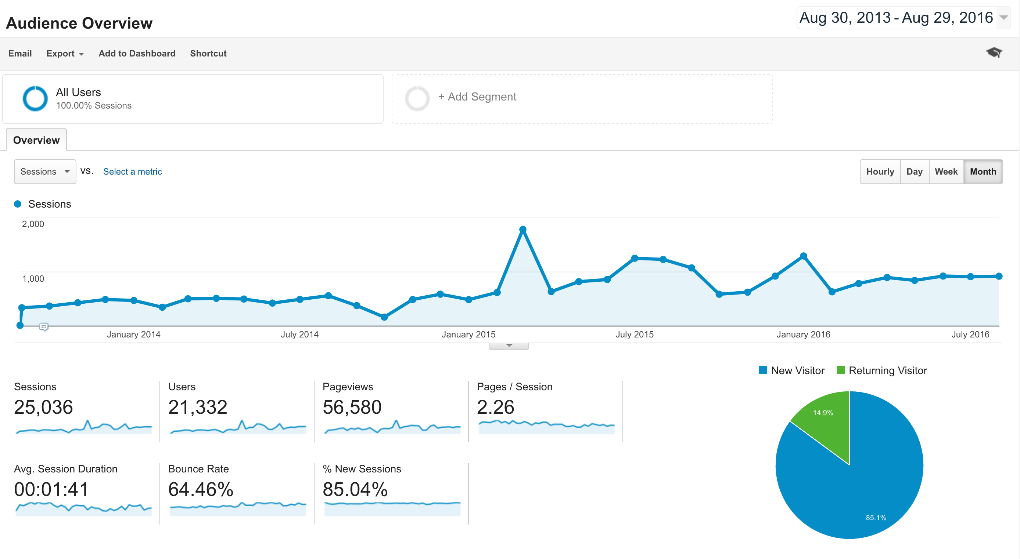

Slide 53
